Slide 1
Auto ReTest Function with GPIB Log
HT-9xxx Series
RD5
Steven Chou
2017.01.26
Rework @ 2022.09.06

Slide 2



Communication Flow
General Flow of ART
Handler
Tester
Initial Lot
Lot Info
Doing FT test
FT Lot End
Request FT lot End
Print Summary
RT Start
Auto Move RT Tray to Loader
Doing RT test
RT Lot End
Yes
Need RT?
No
Request Final Lot End
Print Summary
Lot End

Slide 3
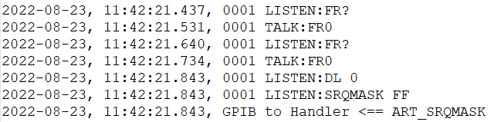
Communication Flow
Initial Tester Connection of ART
Handler
Tester
Tester Connect
FR?
FR0
DL 0
SRQMASK FF
Go to Lot Information

Slide 4
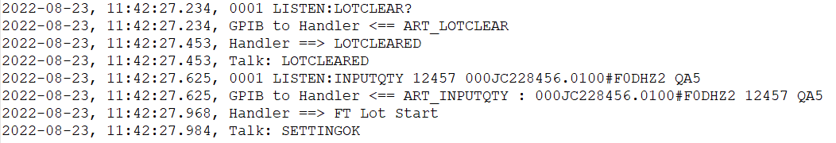
Communication Flow
Initial Lot Information of ART
Handler
Tester
Initial Lot
NN : Lot IC count.
XX : Lot ID
LOTCLEAR?
LOTCLEARED
INPUTQTY NN,XX
SETTINGOK / SETTINGNG
Got SETTINGOK?
No
Yes
Go to FT Lot Start

Slide 5
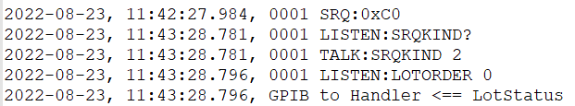
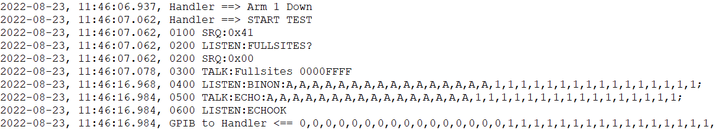
Communication Flow
FT Lot Start
Handler
Tester
FT Lot Start
SRQ 0xC0
SRQKIND?
2 : First time lot start
SRQKIND 2
Tester is ready for testing.
LOTORDER 0
Testing
Go to Lot End Flow

Slide 6
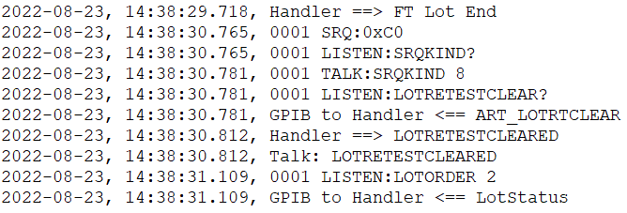
Communication Flow
Lot End
Handler
Tester
Lot End
SRQ 0xC0
SRQKIND?
No
Need RT?
8 : FT / RT Lot End.
Yes
SRQKIND 8
LOTRETESTCLEAR?
LOTRETESTCLEARED
2 : Print summary.
LOTORDER 2
Go to Final Lot End
Auto Move RT Tray to Loader
Go to RT Lot Start

Slide 7
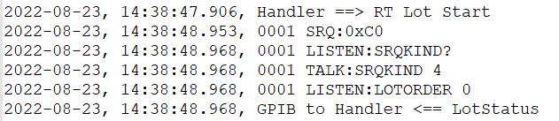
Communication Flow
RT Lot Start
Handler
Tester
RT Lot Start
SRQ 0xC0
4 : RT lot start
SRQKIND?
SRQKIND 4
Tester is ready for testing.
LOTORDER 0
Testing
Go to Lot End Flow

Slide 8
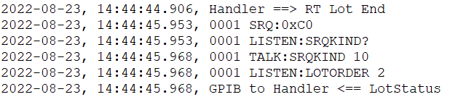
Communication Flow
Final Lot End
Handler
Tester
Final Lot End
SRQ 0xC0
10 : Final lot end
SRQKIND?
SRQKIND 10
2 : Print summary.
LOTORDER 2
Tray Feed and End of ART Flow

Slide 9
Communication Flow
Command List of ART
Tester Command | Description | Reply by Handler
LOTCLEAR? | Request to clear lot data on handler. | LOTCLEARED : all lot data is cleared. SETTINGNG : can not cleat lot data.
INPUTQTY NN,XX | Set lot quantity to handler. NN is count of IC in lot. XX is Lot ID. | SETTINGOK : nothing error. SETTINGNG : can not set lot data.
SRQKIND ? | Asking handler for running status. | SRQKIND 2 : FT lot start. SRQKIND 4 : RT lot start. SRQKIND 8 : lot end. SRQKIND 10 : final lot end.
LOTORDER X | By the SRQKIND command, tester will reply LOTORDER. | LOTORDER 0 : handler can start running. LORORDER 2 : Reply to perform ART or clean out lot end.
LOTRETESTCLEAR? | Request to clear lot data on handler. | LOTRETESTCLEARED: all lot data is cleared. SETTINGNG : can not cleat lot data.

Slide 10
Thank you

